Slide 1
Basho Corp
Power point Template
Your Name Here
Feb 15, 2015

Slide 2
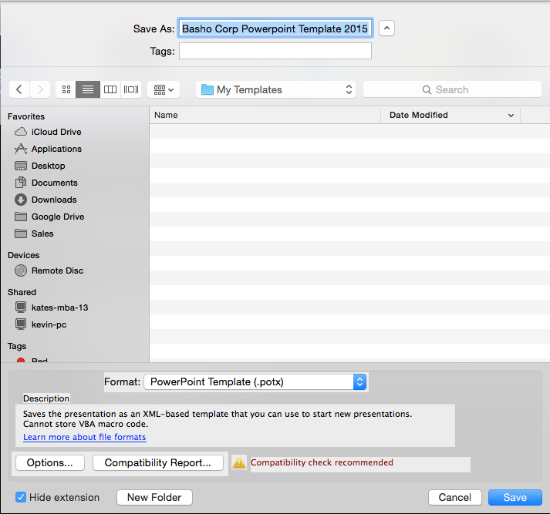
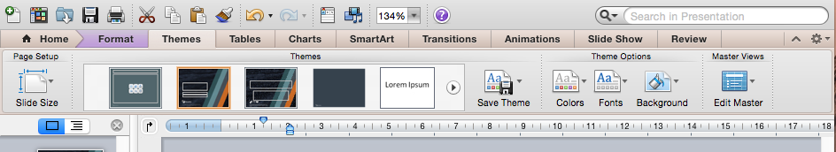
How to Install
Installing a template and setting the default theme
  File > Save As…
  In the format pop-up menu choose PowerPoint Template.potx
  Unless you select a different location, the template is saved in /Users/ username/Library/Application Support/Microsoft/Office/User Templates/My Templates.
  To use it for your next presentation after this just click on File > New From Template and pick from My Templates
By setting a default theme to ensure that the Basho colors are default in your system
  On the Themes ribbon under Format click on Save Theme to set the Basho colors

Slide 3
Slides
Following are some example slides with basho graphics you can use
Delete and add slides to create your presentations

Slide 4


















Graphic Icons you can use
DEVELOPERS
OPERATIONS
CUSTOMERS
SALES
SETS
FLAGS
USERNAME
REGISTERS
GROUPS
MAPS
PASSWORD

Slide 5



RIAK 2.0
TIERED STORAGE
THESE ARE TEXT EDITABLE BANNERS – PLEASE KEEP SIMPLE TO WORK THE BEST
YOU CAN ENLARGE OR REUSE TEXT – THESE ARE ALSO GROUPED
COPY AND PASTE TO THE SLIDE YOU WISH
RIAK 2.0
RIAK 2.0
OVERVIEW

Slide 6
lists
List of Key points
Key point 2
Key point 3
Key point 4

Slide 7
Jigsaw pieces

Slide 8
Example of bullet
List in Green
Keep your text simple
Focus on creating visual, audience-focused presentations
  Slides are aides
    Not a copy
      A picture speaks

Slide 9
Notes in green
List line 1
Hot topic line 2
Shopping list 3
Important note 4

Slide 10
Questions

